Slide 1
What are emerging trends in HRM?
What are the emerging trends for HR in 2023?
These include technological advancements, remote work, diversity and inclusion, employee well-being, data-driven decision-making, skills development, and Agile HR practices.
Embracing these trends will be crucial for HR professionals to thrive in 2023 and beyond.

Slide 2
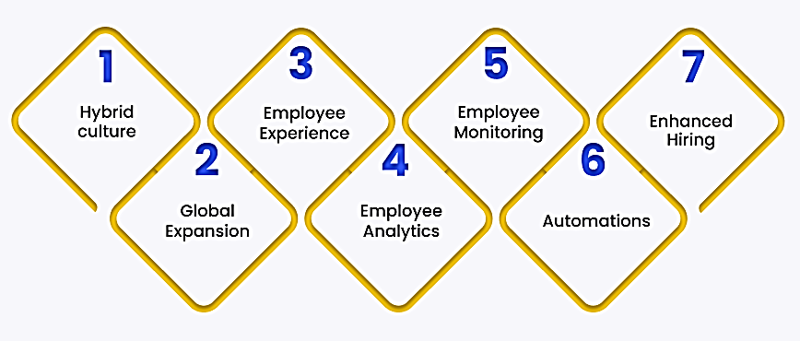
Emerging Trends in HR

Slide 3
What are the HR trends and
priorities?
Turnover, retention, engagement, productivity, and a company's ability to increase diversity, equity, and inclusion are the top HR metrics heading into 2023.
Together, they will improve employee experiences and the workplace overall.

